Slide 1
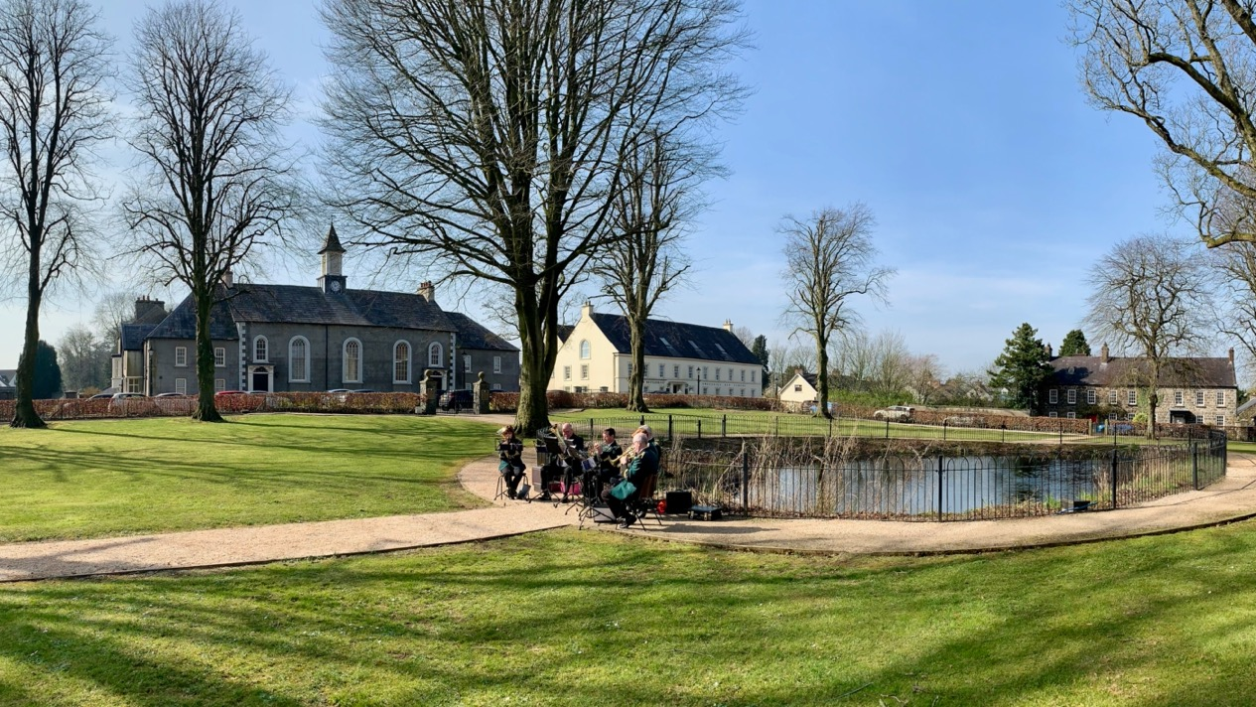
Gracehill, a Moravian Church Settlement
Representation, and the value of global comparative analysis
Barry Gamble ・ TheNext50・ Paris ・ 8 February 2023

Slide 2
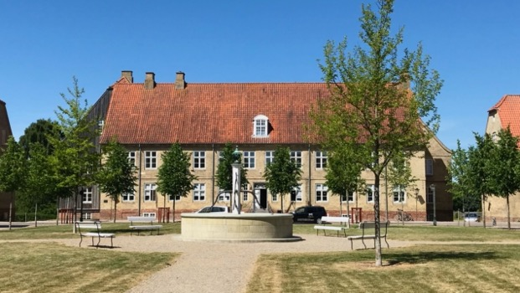
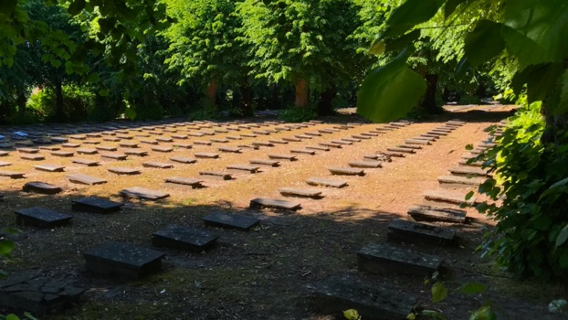
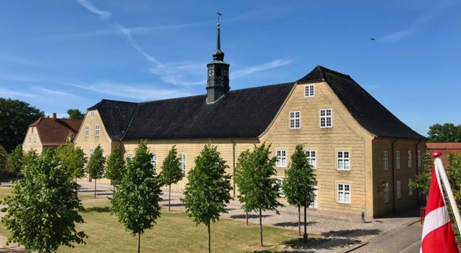
Christiansfeld, a Moravian Church Settlement (Denmark)
Inscribed as a World Heritage Site (2015)
The best representative Moravian Church settlement in northern Europe
Expression of the Moravian ‘ideal city’
Outstanding Moravian buildings
High integrity, authenticity, and state of conservation
Recommendation by the World Heritage Committee to ‘extend’ by a transnational serial nomination to better represent the Moravian Church ‘phenomenon’

Slide 3
Comparative Analysis Purpose: To make clear what makes the property outstanding both in its national and international context In the case of serial nominations, the text needs to set out the rationale for choosing the component parts, in terms of comparing them with other similar component parts and justifying the choice made. The comparative analysis must be analytical and draw conclusions! It can be simply structured in three parts: 1. Framework for comparison 2. Assessment 3. Conclusion

Slide 4
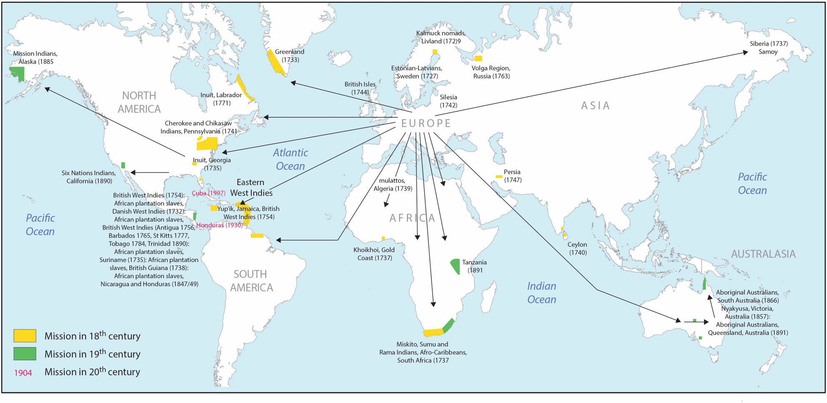
Comparative Analysis framework – a global context

Slide 5
Methodology
Values and attributes of the nominated property as the basis for comparison
Cultural values Criterion (iii) exceptional testimony to a cultural tradition (living) | Town Planning values Criterion (iv) outstanding urban typology | Architectural values Criterion (iv) outstanding architecture
Historical and continued presence, ownership, and influence of the Moravian Church, its liturgy, calendar, and interactions with the town and its buildings and spaces. Geo-cultural and geographical reach. | Outstanding example of the ‘Ideal city’ concept, with its street system and ensemble of special buildings and functional spaces with placement relative to one another guided by religious and societal ideas and beliefs. Temporal sequence of development of the network of settlements. | Unique architectural style of ‘Moravian Church Civic Baroque’, with regional architectural influences and in materials and traditions, together with special building types (including prototypes) with outstanding form and design and high-quality craftmanship.

Slide 6
Assessment
Candidate Moravian Church settlements , as opposed to missions stations, were carried forward into the comparative study, divided into the three key geographical regions:
I European Continental (Germany, Denmark, the Netherlands):
Herrnhut (Germany, 1722), Herrnhaag (Germany, 1738), Zeist (the Netherlands, 1746), Ebersdorf (Germany, 1746), Neuwied (Germany, 1750), Kleinwelka (Germany, 1751), Neudietendorf (Germany, 1753), Gnadau (Germany, 1767), Christiansfeld (Denmark, 1773), Königsfeld (Germany, 1807).
II United Kingdom of Great Britain and Northern Ireland (England and Northern Ireland): Fulneck (1744), Ockbrook (1750), Gracehill (Northern Ireland, 1759), Fairfield (1785).
III North America (former British colonies): Bethlehem (1742), Salem (1771).
Qualitative comparative analysis was undertaken to determine similarities, differences, and contributions to the series - as a whole. Conclusions were then drawn, and a selection made on the prime basis of technical justification combined with direct input from State Parties who wished to participate.

Slide 7
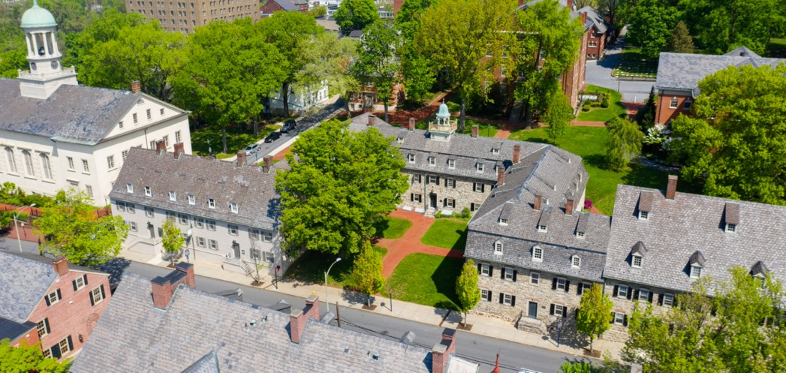
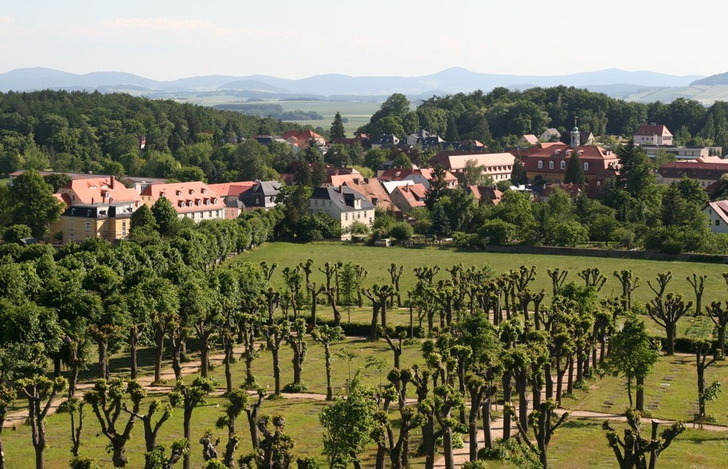
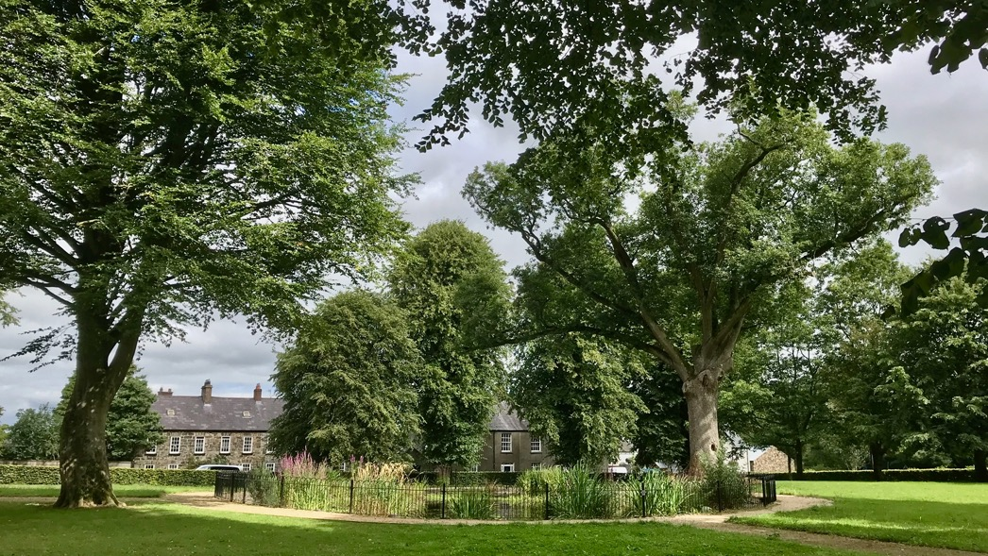
Conclusion
Bethlehem (Pennsylvania, USA)
Herrnhut (Saxony, Germany)
Gracehill (Northern Ireland, UK)

Slide 8
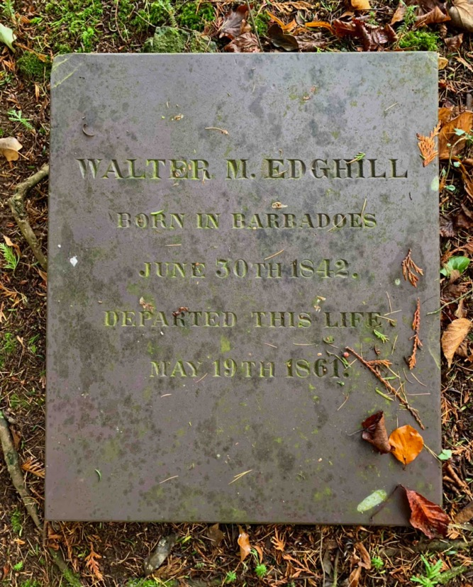
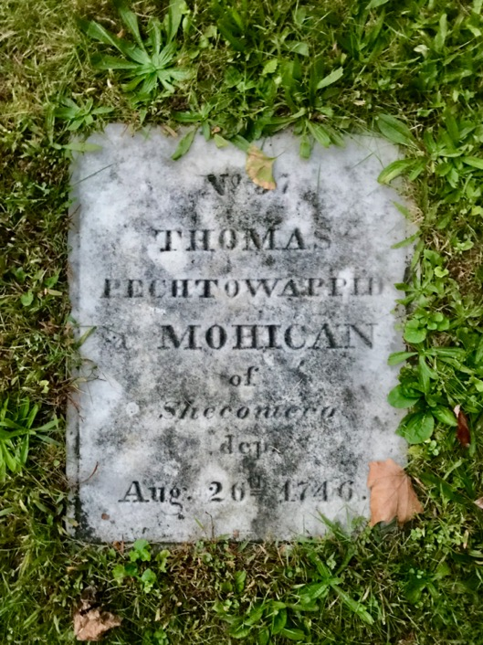
The Moravian Church remains the overarching stakeholder in a global network of sites.

Slide 9
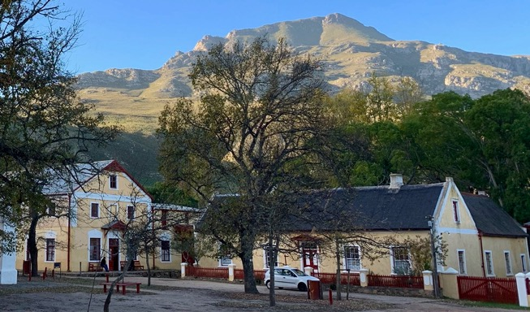
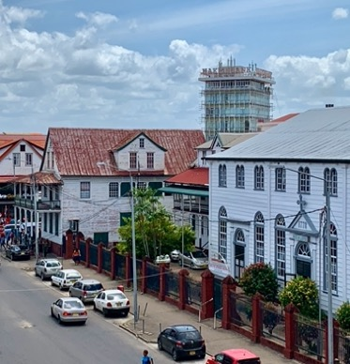
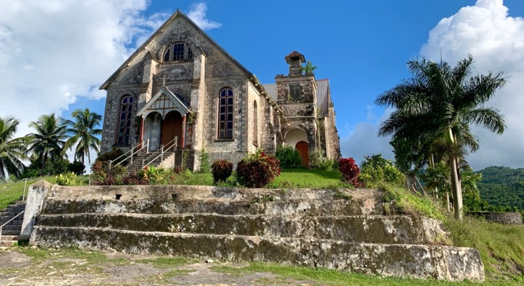
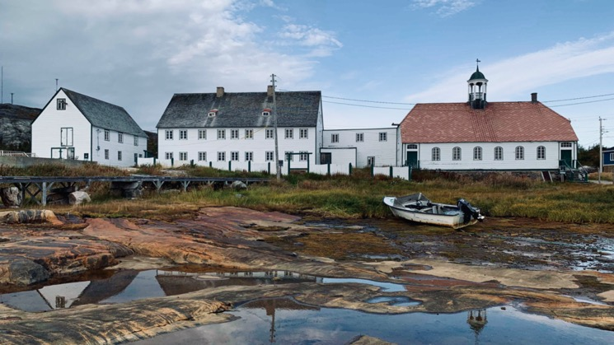
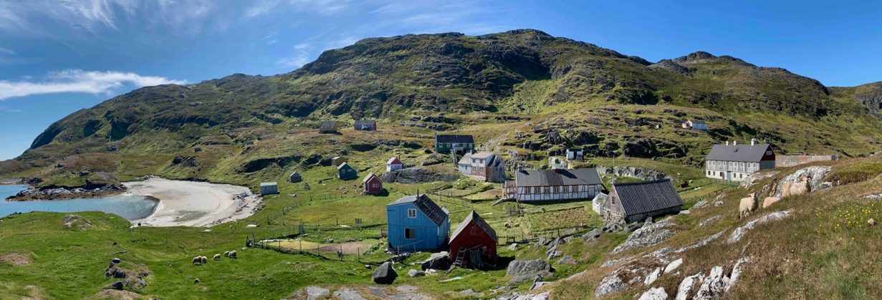
The comparative study also investigated Moravian Church Mission Stations; the best of nearly 200 being visited to create an inventory

Slide 10
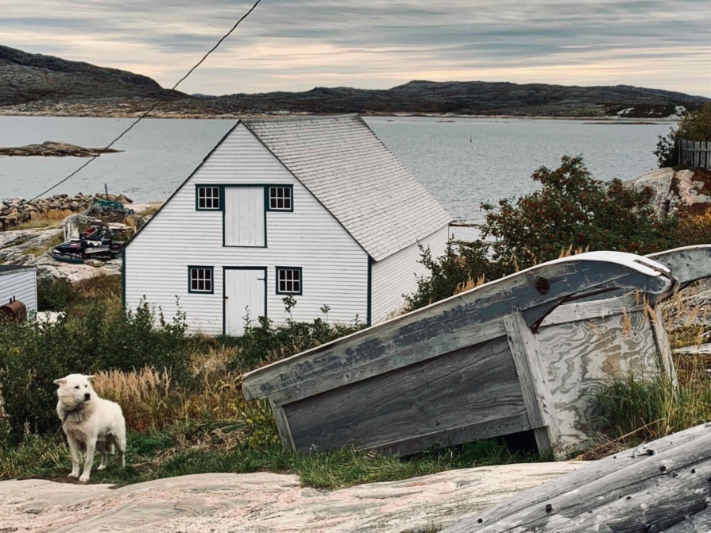
Moravian Church Missions – A fuller representation of the Moravian Church ‘phenomenon’ on the World Heritage List, bringing World Heritage to unrepresented countries
Thank you.

